Slide 1
Open Source Solution for Navigation System
Xun(Perry) Liu
4/10/2019

Slide 2
About myself
05/2009
01/2010
03/2013
06/2014
04/2018
Micro: Hybrid navigation solution supports Nav and Search
RMU, Tech Lead, simplify internal solutions
NGX, “Head of War Room”,
New infrastructure for Incremental update
Join Nav Team
OSRM
Valhalla

Slide 3
Agenda
Story 1: How Valhalla organize map data for map streaming
Story 2: How OSRM calculate route with dynamic information
Story 3: How Lyft do map matching when map data is wrong

Slide 4
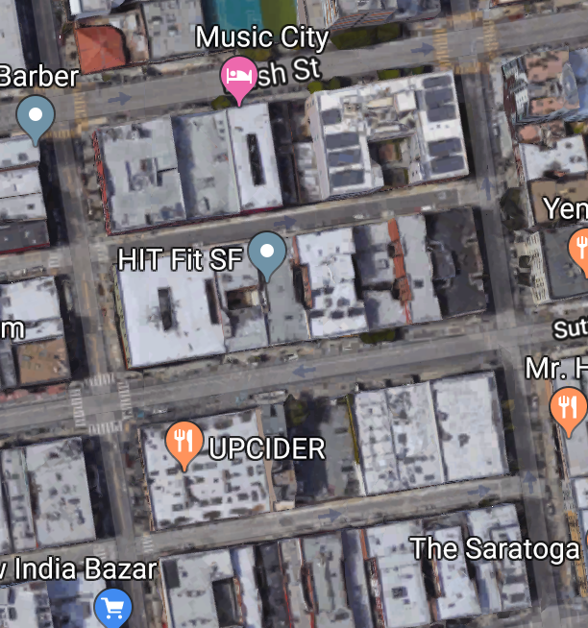
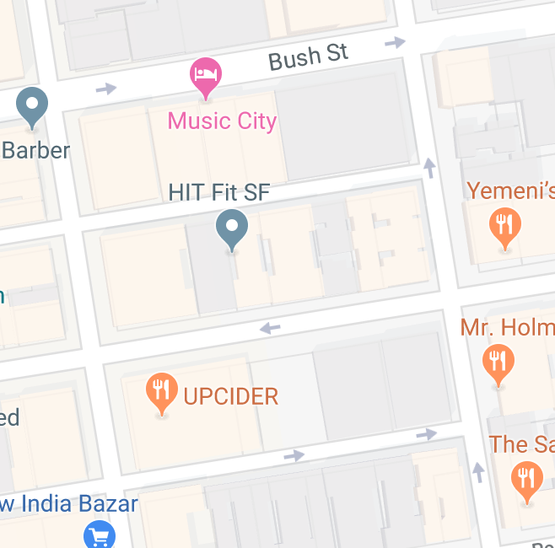
Terminology
Node
Tile1
End
Shortest Path
Tile2
Edge
Start
Graph

Slide 5
Agenda
Story 1: How Valhalla organize map data for map streaming
- Background
- Ngx’s solution
- Valhalla’s solution
Story 2: How OSRM calculate route with dynamic information
Story 3: How Lyft do map matching when map data is wrong

Slide 6


Story #1. How Valhalla organize mapdata for map streaming
Streaming for offline navigation

Slide 7
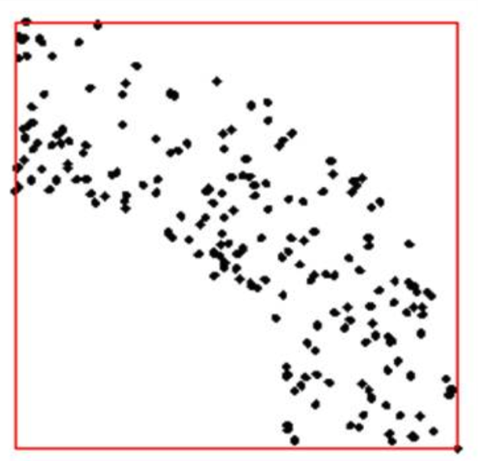
How to store data
Problem to solve: How to find nearest charge station for your EV?
Notes:
Assume all rider is just at static location
Group elements near each other together
Group size should be balanced

Slide 8
Agenda
Story 1: How Valhalla organize map data for map streaming
- Background
- Ngx’s solution
- Valhalla’s solution
Story 2: How OSRM calculate route with dynamic information
Story 3: How Lyft do map matching when map data is wrong

Slide 9
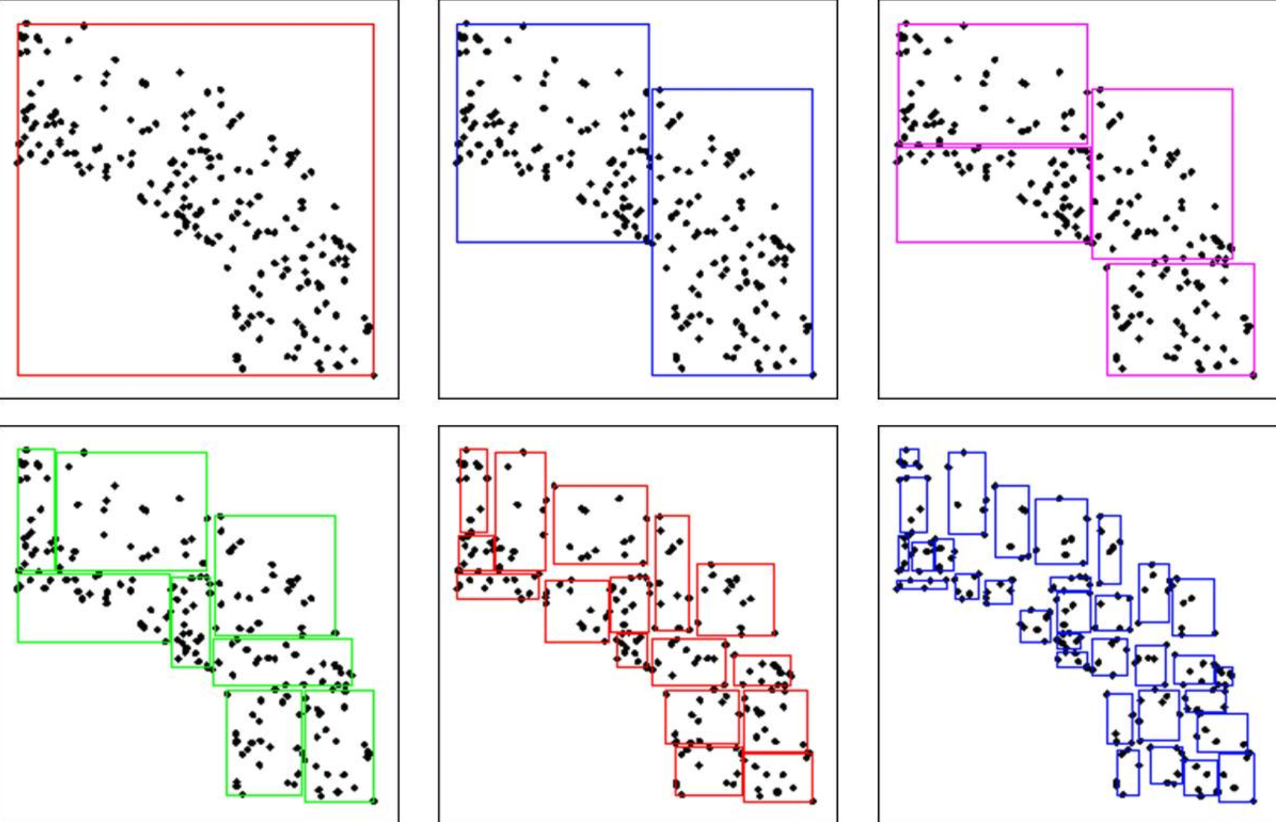
NGX Solution - Divide based on content
Tiles size are balanced(average file size is 700KB)
Element might move to different tile during data update
Notes:
Add current data statistics

Slide 10
Agenda
Story 1: How Valhalla organize map data for map streaming
- Background
- Ngx’s solution
- Valhalla’s solution
Story 2: How OSRM calculate route with dynamic information
Story 3: Map Lyft do map matching when map data is wrong

Slide 11
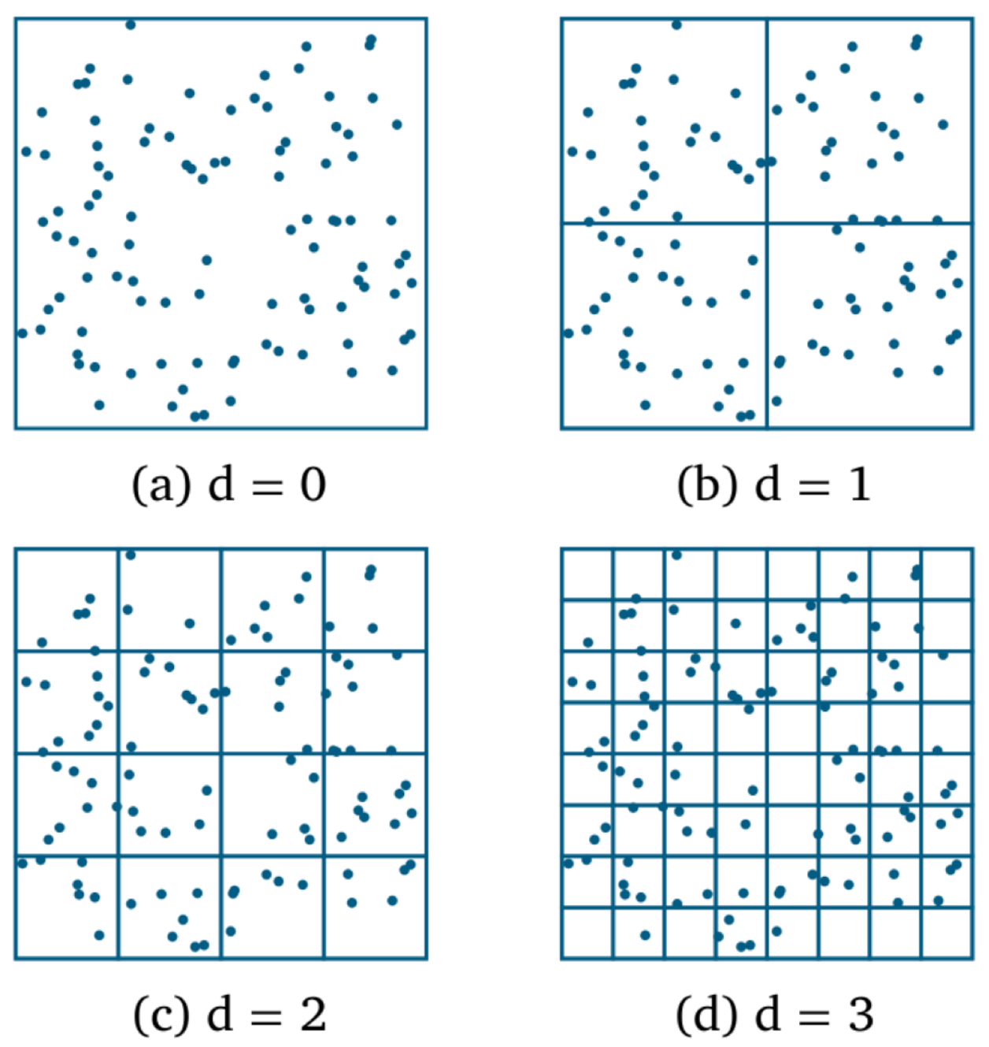
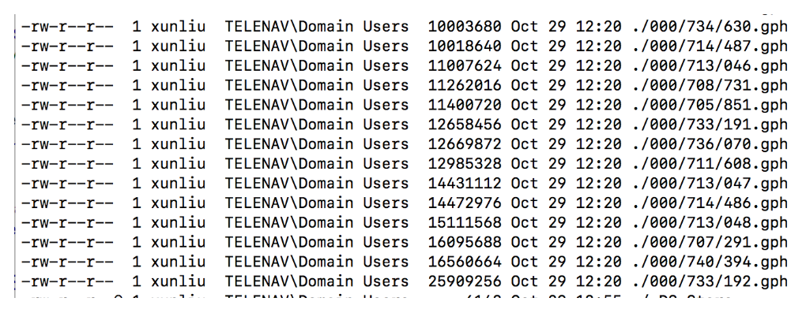
Valhalla’s Solution - Divide based on map
Fixed boundary split
Element will stay in fixed grid as long as no change for geometry
Tile id could be calculated by lat/lon
Cacheability/Updateability
File size depend on data density
25MB

Slide 12
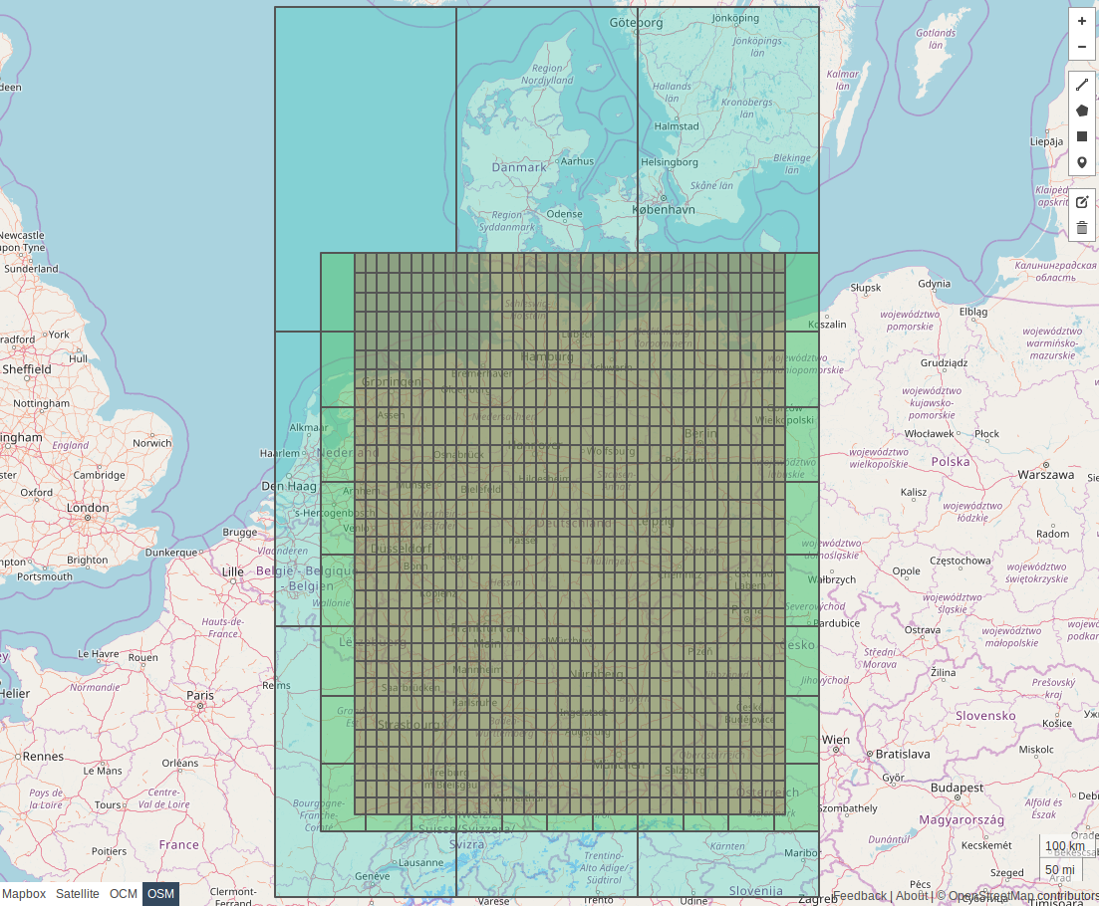

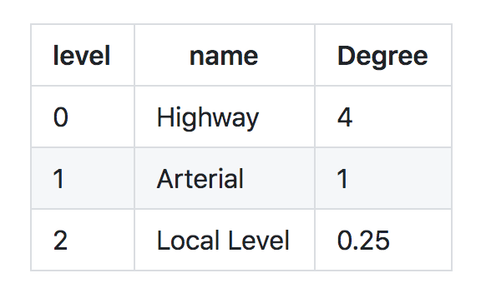
Valhalla Tiles

Slide 13
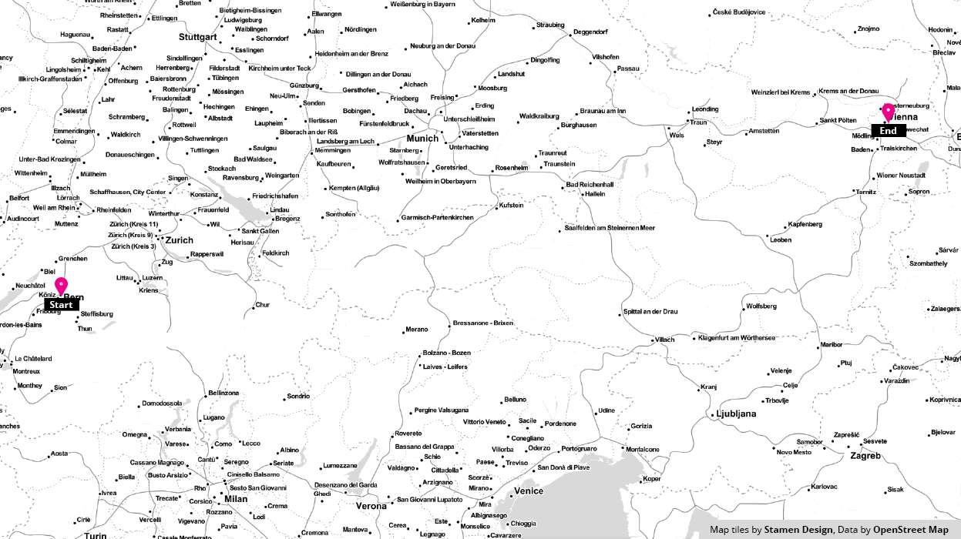
Valhalla Streaming
Notes:
What is Valhalla

Slide 14

Lesson learned from Valhalla
Fixed size tiles make streaming easier, but have impact on performance and memory
Improvement on Current product
Fix boundary at space level, then try at tile level

Slide 15
Agenda
Story 1: How Valhalla organize map data for map streaming
Story 2: How OSRM calculate route with dynamic information
- Background
- Ngx’s solution(FC promotion)
- OSRM’s solution(CRP)
Story 3: Map Lyft do map matching when map data is wrong

Slide 16

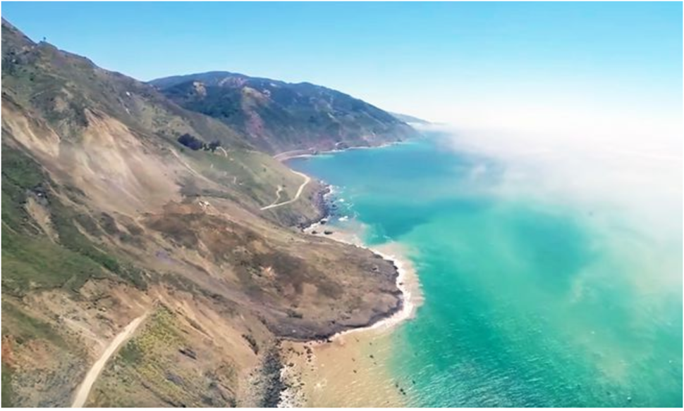
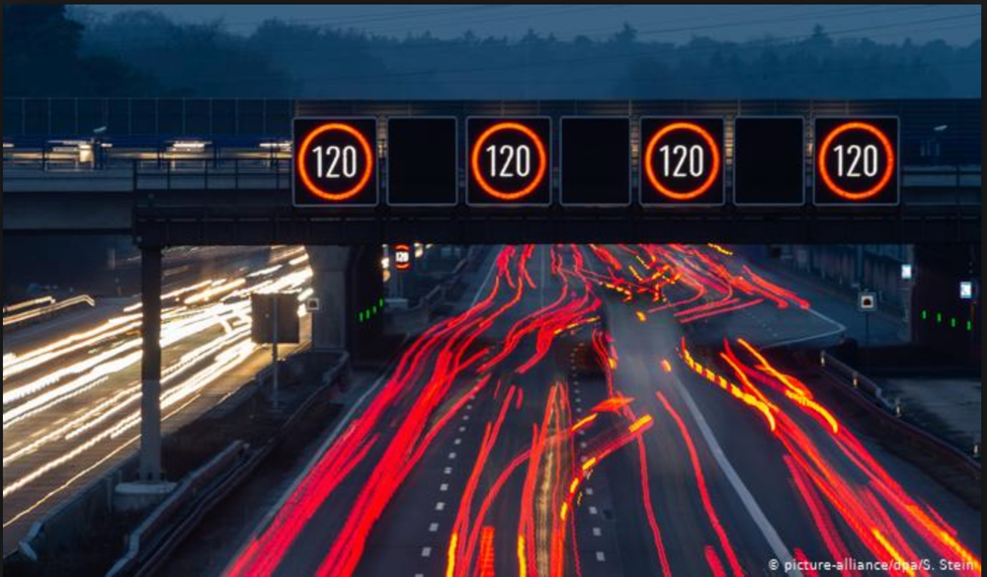
Story #2 Calculate route consider dynamic information

Slide 17
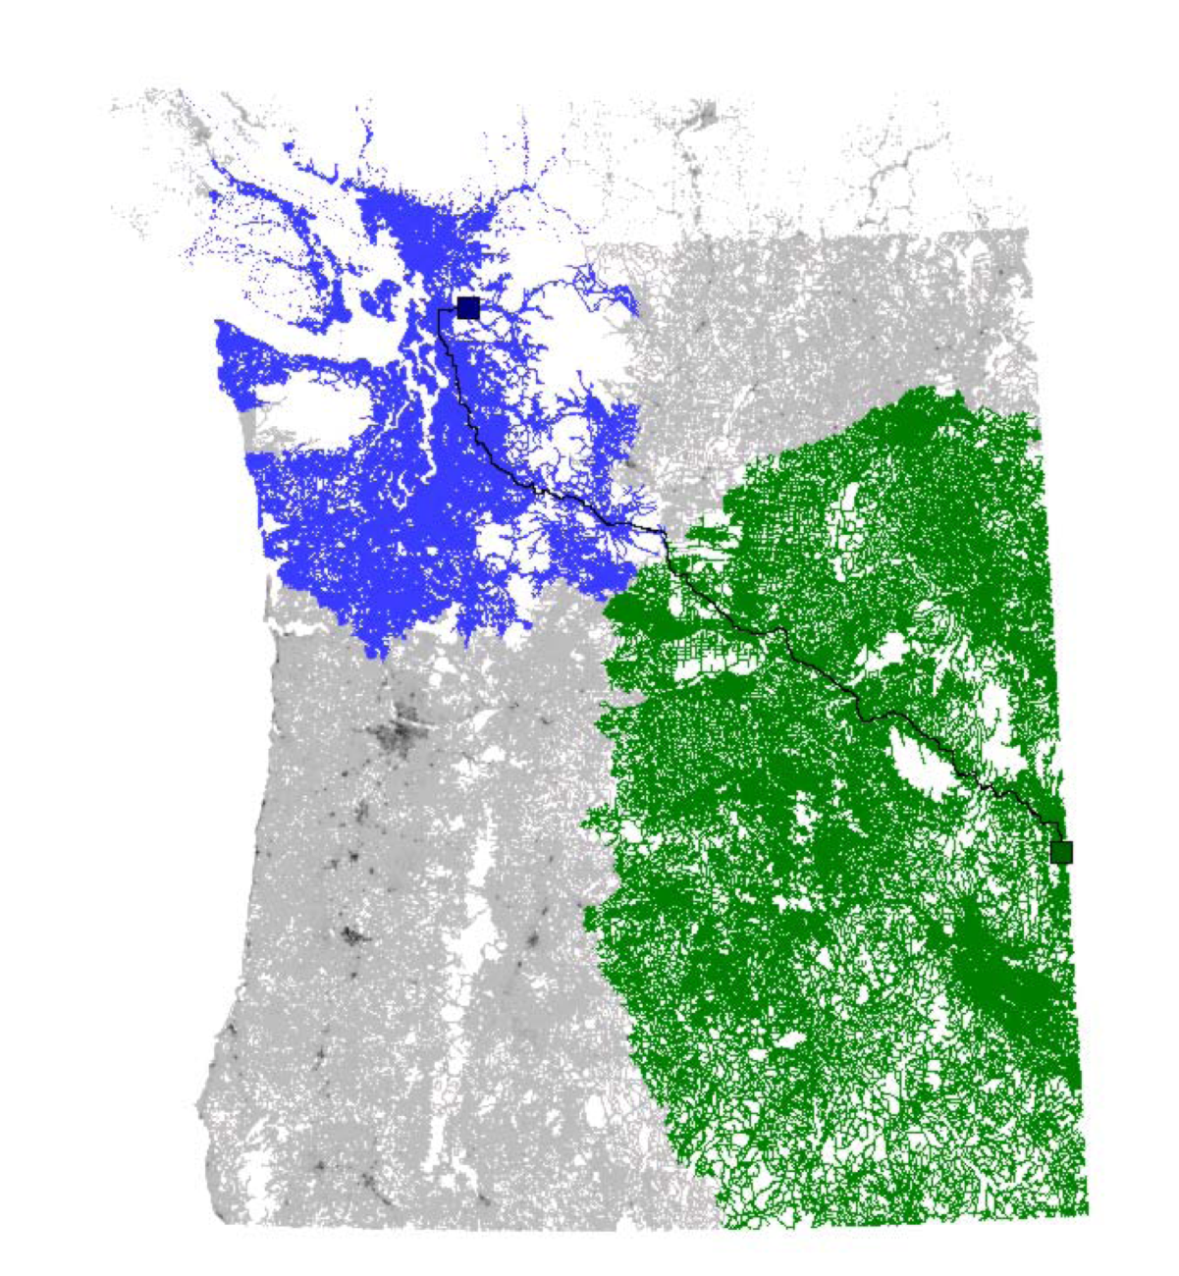
Story #2 Calculate route consider dynamic information
Chanllege of routing + dynamic information
40M edges for HERE NA
80M edges for HERE EU
Notes:
Dikjstra

Slide 18
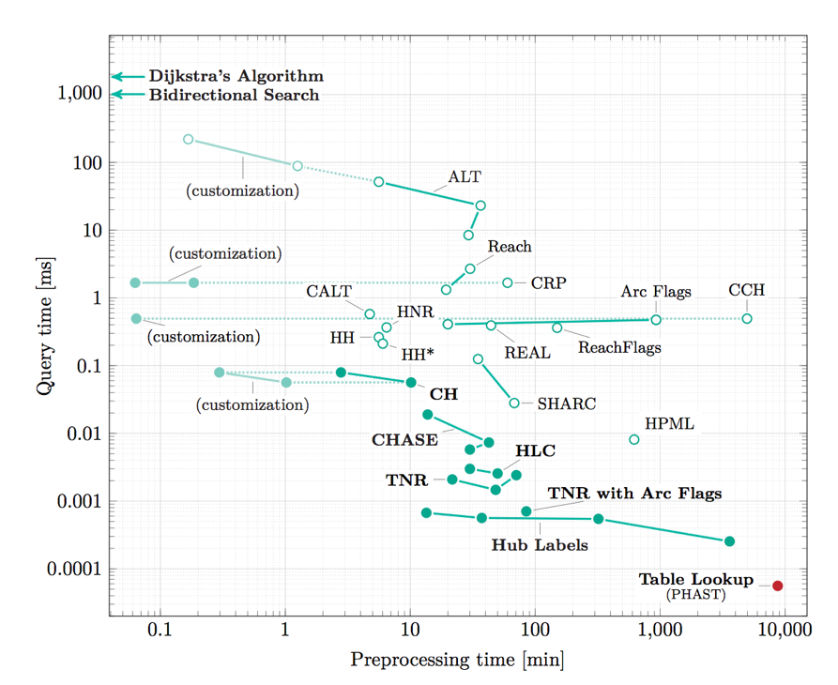
Story #2 Calculate route consider dynamic information
Chanllege of routing + dynamic information
Notes:
Dikjstra

Slide 19
Agenda
Story 1: How Valhalla organize map data for map streaming
Story 2: How OSRM calculate route with dynamic information
- Background
- Ngx’s solution(FC promotion)
- OSRM’s solution(CRP)
Story 3: Map Lyft do map matching when map data is wrong

Slide 20
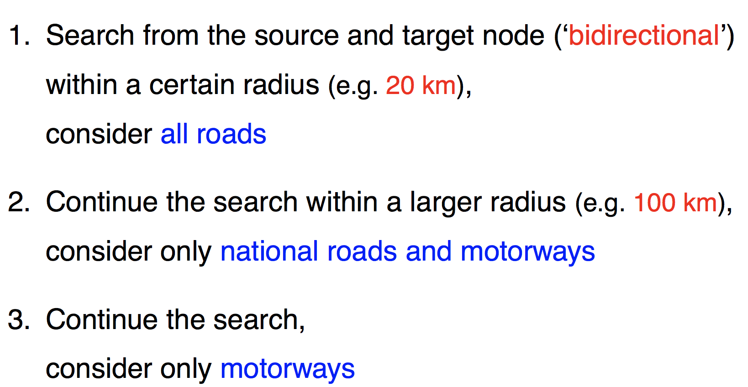
NGX Solution - Function class Level promotion

Slide 21
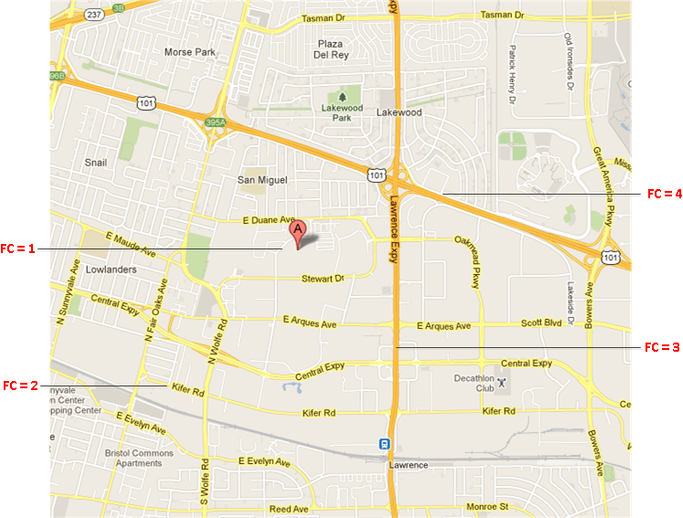
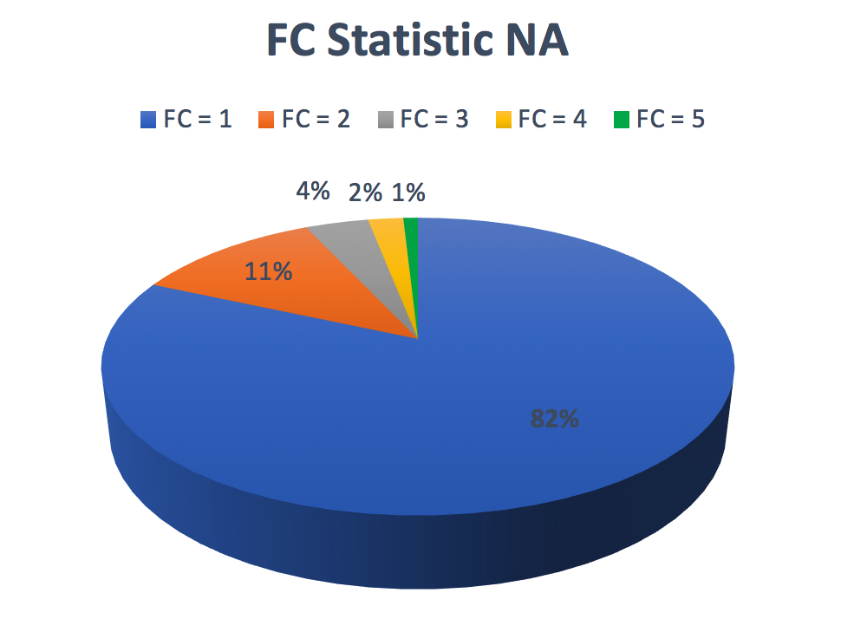
NGX Solution - Function class Level promotion

Slide 22
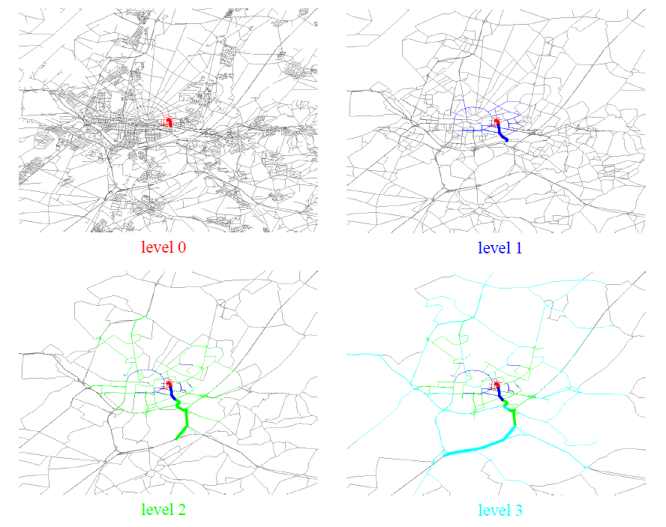
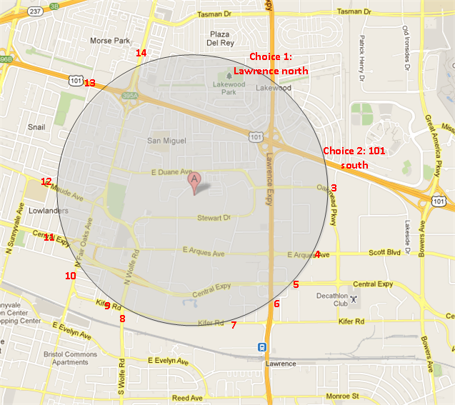
Function class Level promotion
Prune and Shrink
When to promote
Notes:
What is candidate

Slide 23
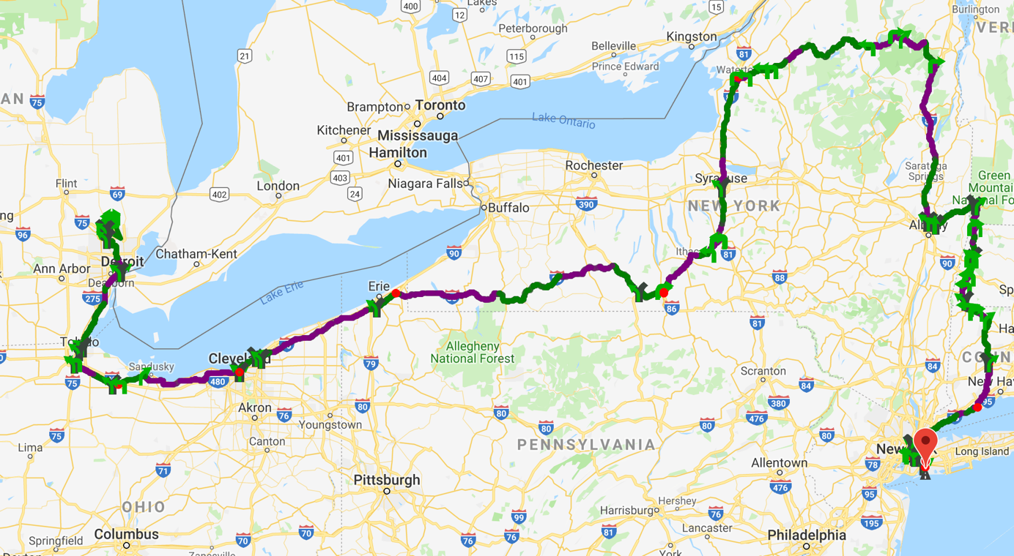
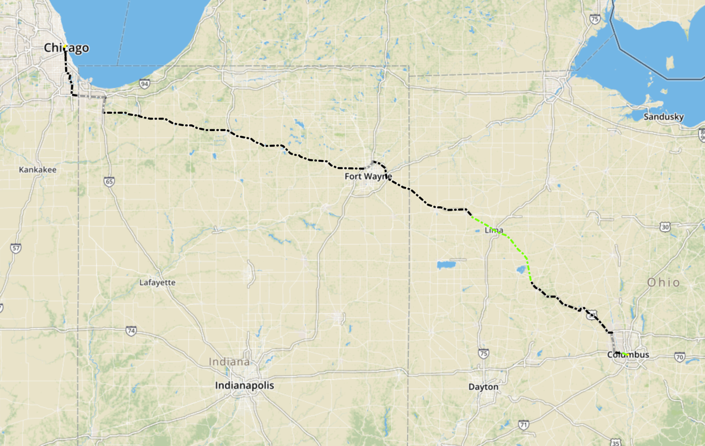
Function class Level promotion
Miss best candidate
Only promote, never look down

Slide 24
Agenda
Story 1: How Valhalla organize map data for map streaming
Story 2: How OSRM calculate route with dynamic information
- Background
- Ngx’s solution(FC promotion)
- OSRM’s solution(CRP)
Story 3: How Lyft do map matching when map data is wrong

Slide 25
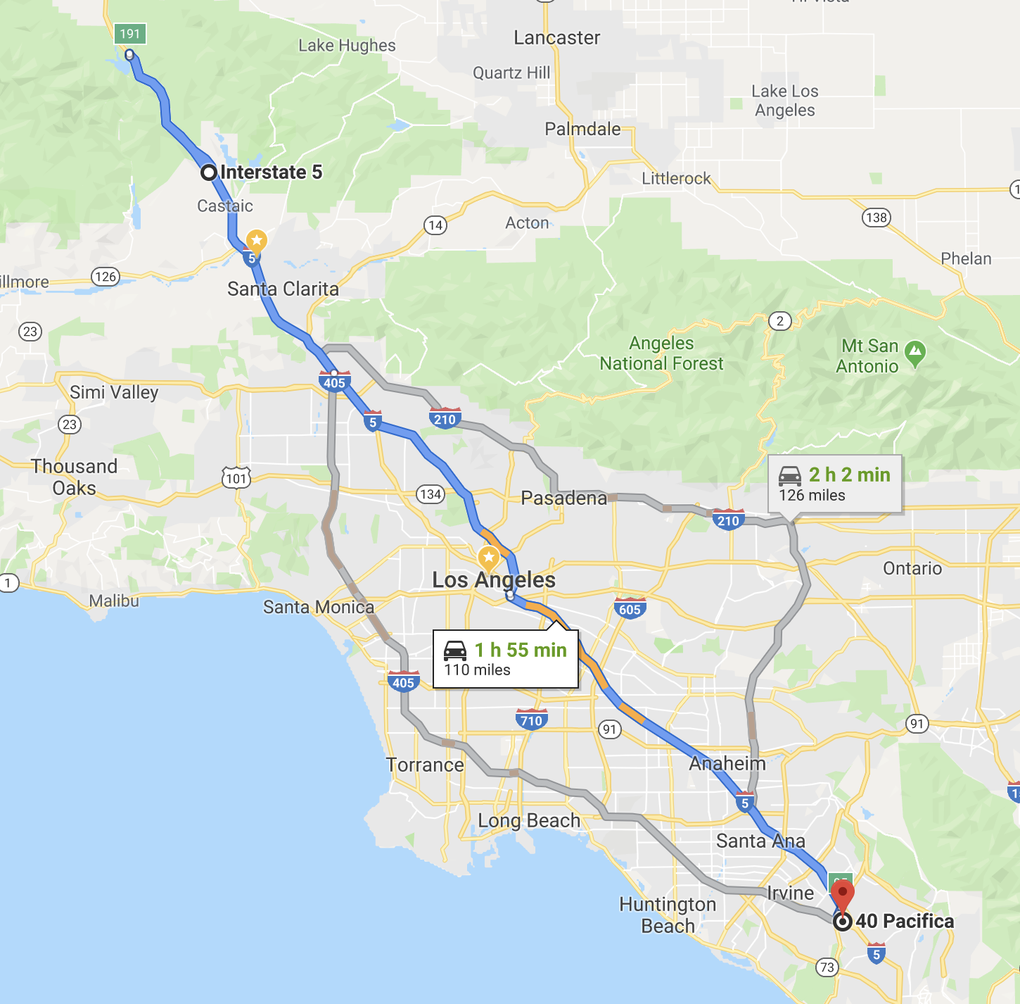
How to calculate route
Notes:
Picture layout

Slide 26
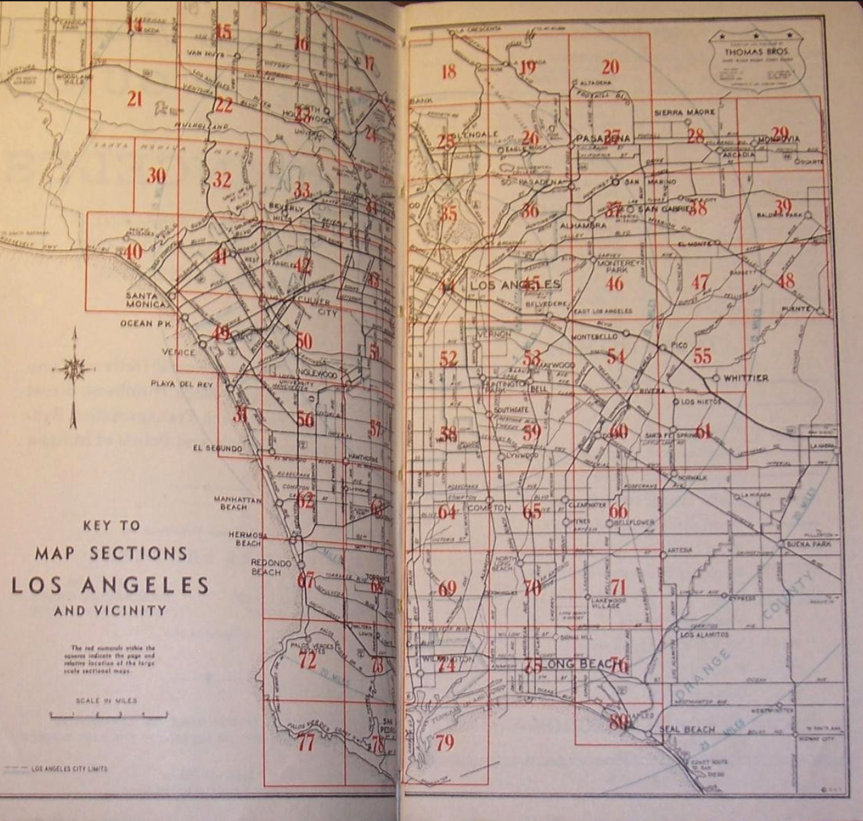
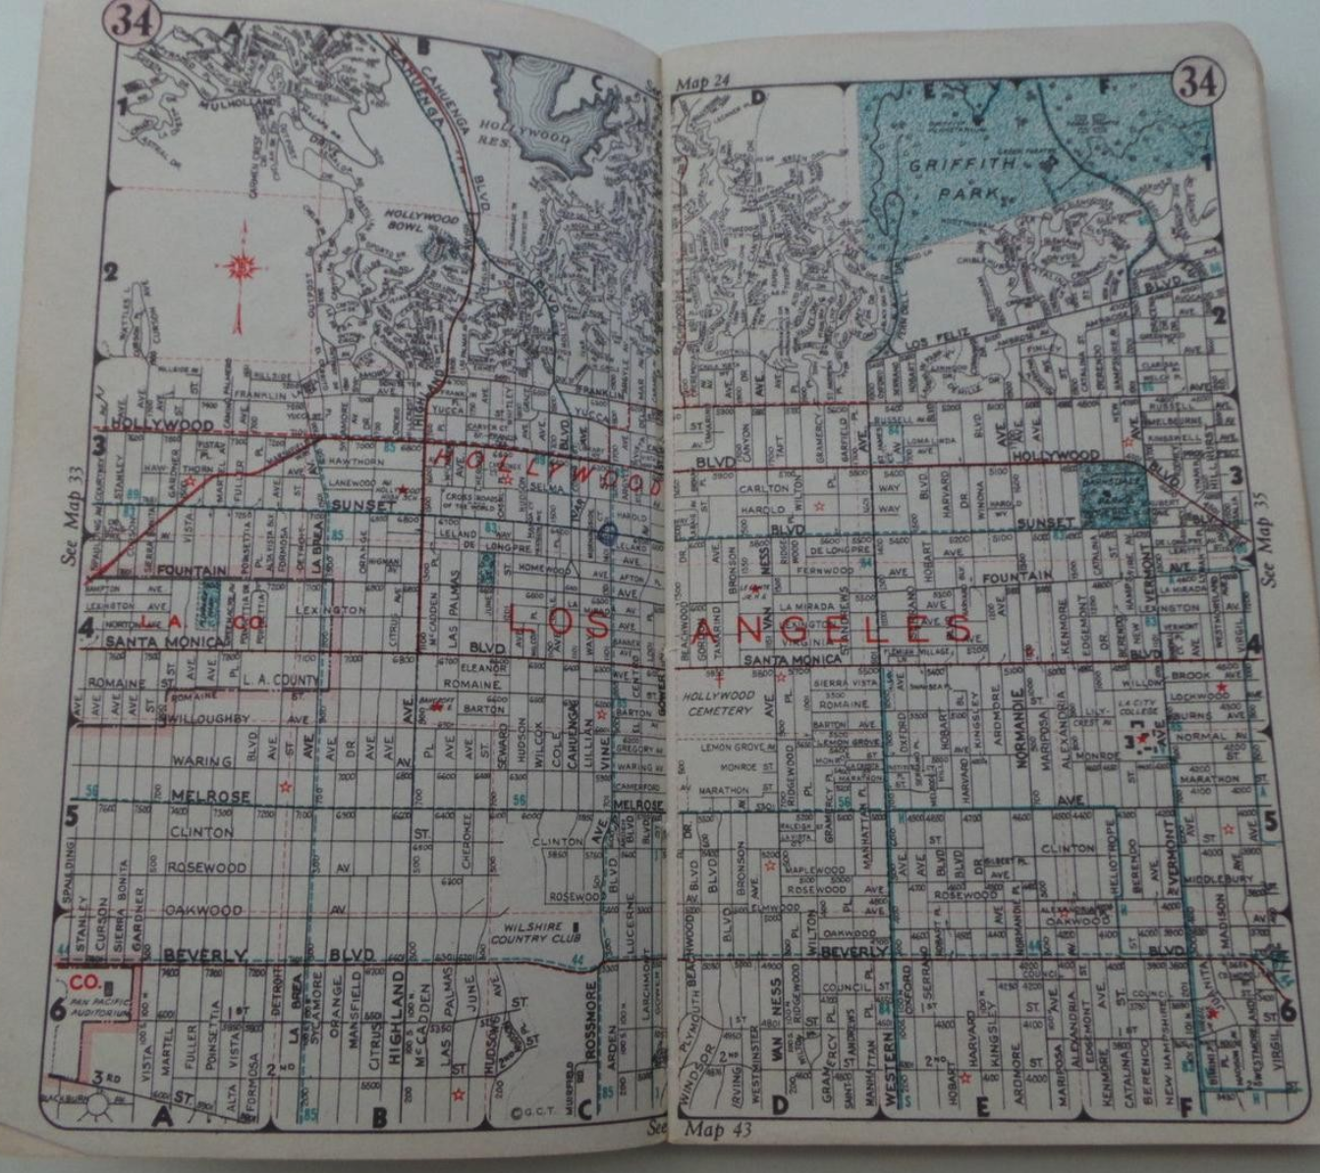
Thomas Guide
Notes:
Picture layout

Slide 27
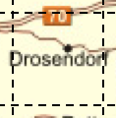
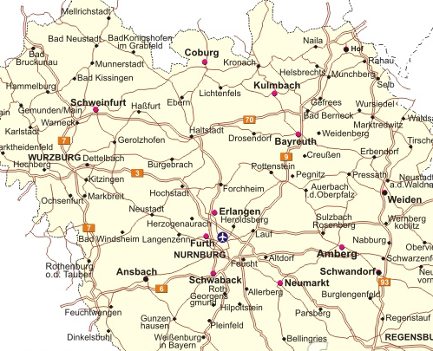
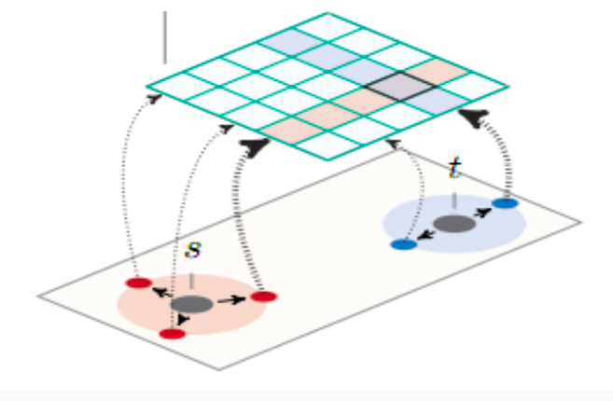
Access Points
Partition the graph
Access Points
Access Points
Keep update cost between access points

Slide 28
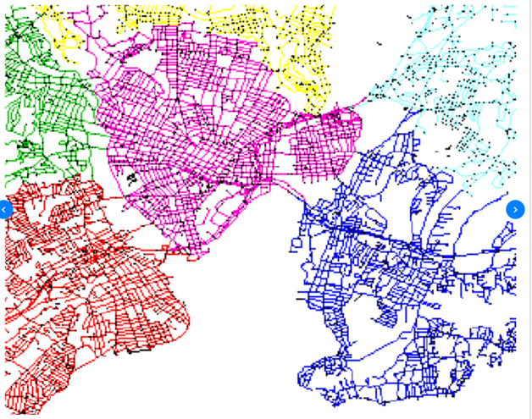
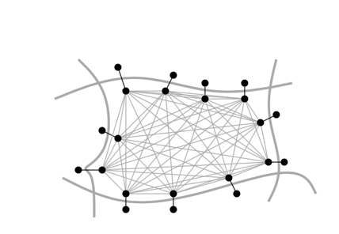
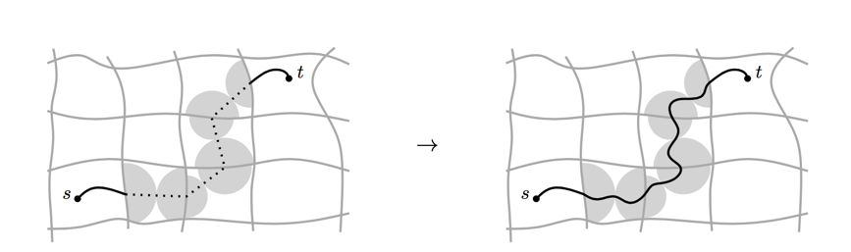
Customizable Route planning
Step 1: Graph preprocessing
Graph partition, preprocessing, hours
Step 2: Customization
Apply dynamic information with cost model
Each round of traffic update, seconds
Step 3: Query
Real time, per request, mili-seconds

Slide 29
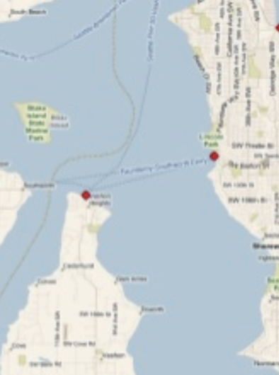
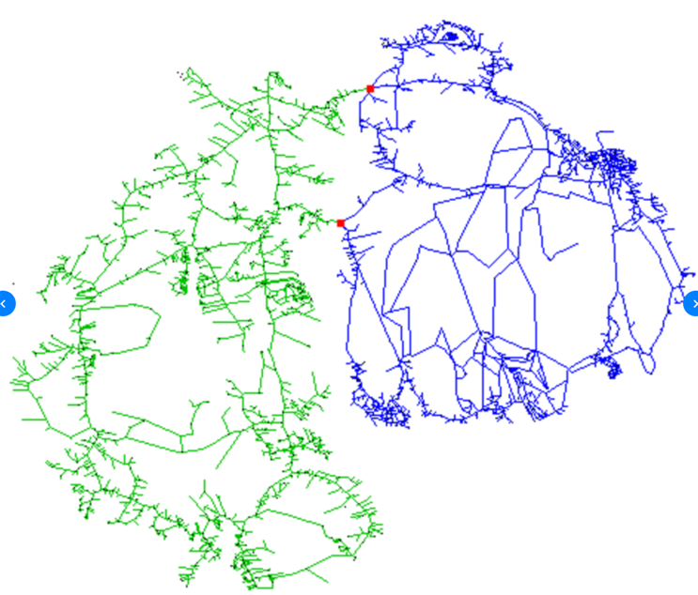
What’s the balanced-minimum cut

Slide 30

Max Flow Min Cut

Slide 31
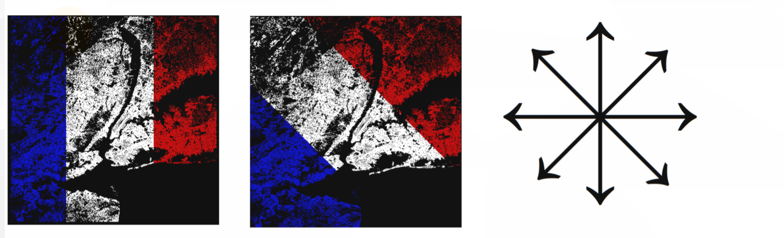
Try different cut to find minimum

Slide 32
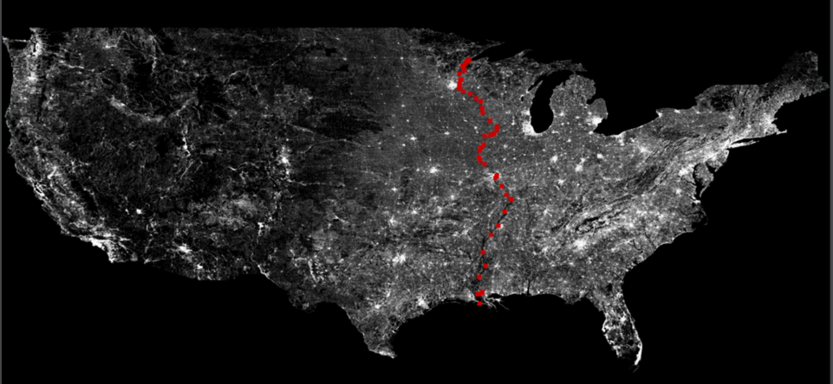
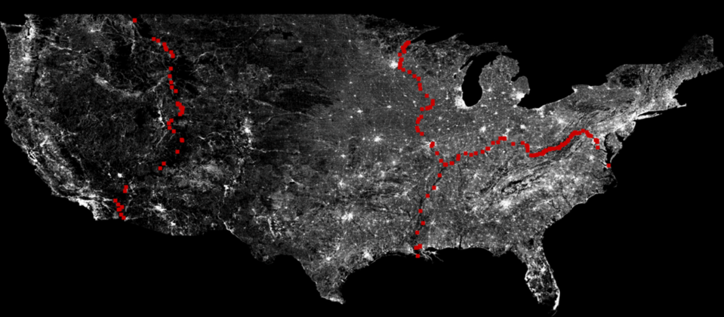
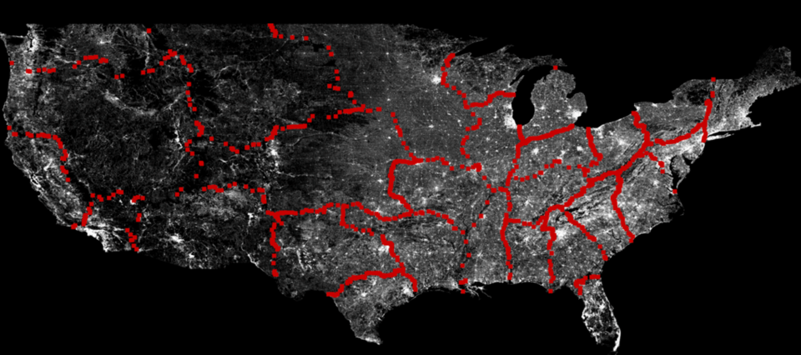
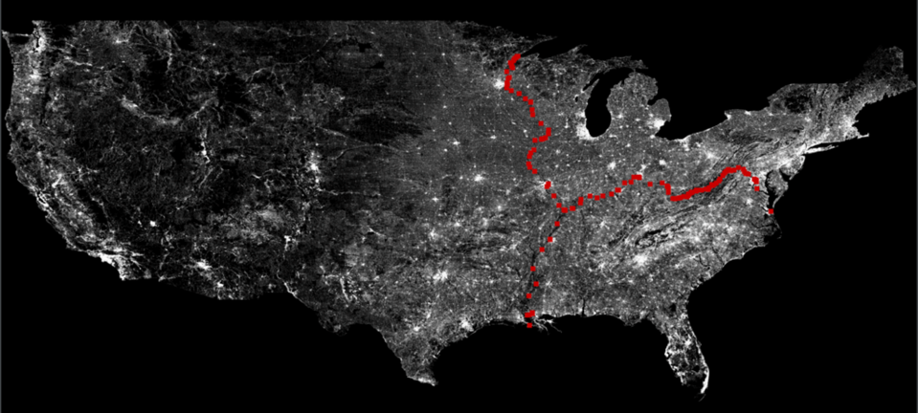
Partition graph of US

Slide 33

Lesson learned from OSRM
Cloud side use different strategy with embedded side
Accurate algorithm matters especially for ML
Improvement on Current product
Container/Dynamic Configuration/Cucumber
Routing as service

Slide 34
Agenda
Story 1: How Valhalla organize map data for map streaming
Story 2: How OSRM calculate route with dynamic information
Story 3: How Lyft do map matching when map data is wrong

Slide 35
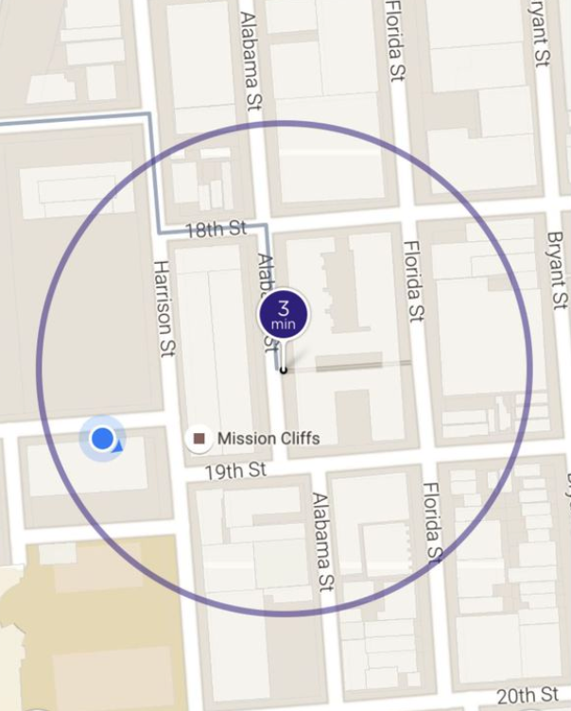
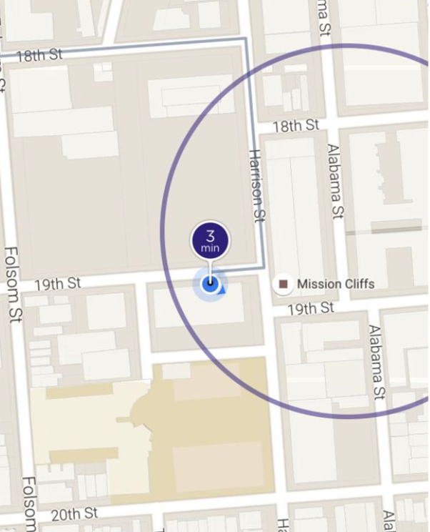
Story #3 Map Matching when the map data is wrong
A story about Lyft pick up
When Map data exists
No Map data
Notes:
The original picture tells the feature of destination adjustment from Lyft

Slide 36
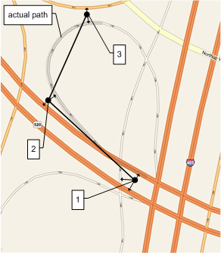
Offline Map Matching
What/How/Why
Give a sequence of GPS signals, find the most probable sequence of road segments
Notes:
What is gps point

Slide 37

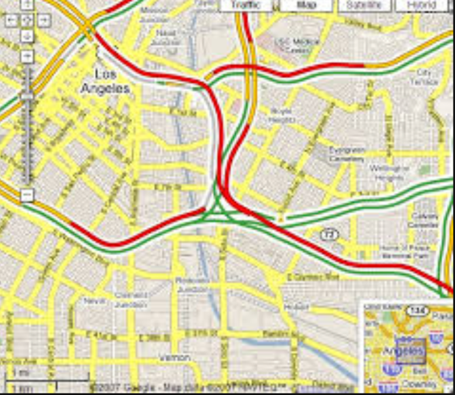
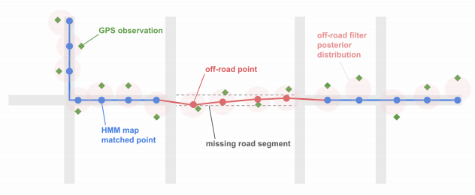
Offline Map Matching
What/How/Why
Historic/Live traffic/ETA
Enhance map data
User pattern
Notes:
Live traffic
Enhance map data
Analysis user pattern

Slide 38
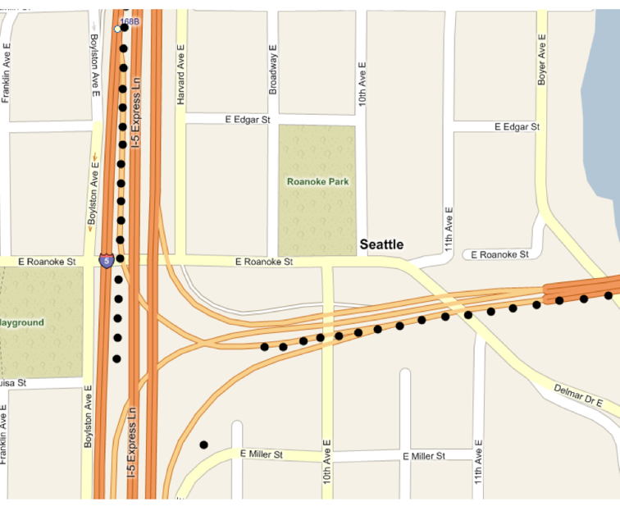
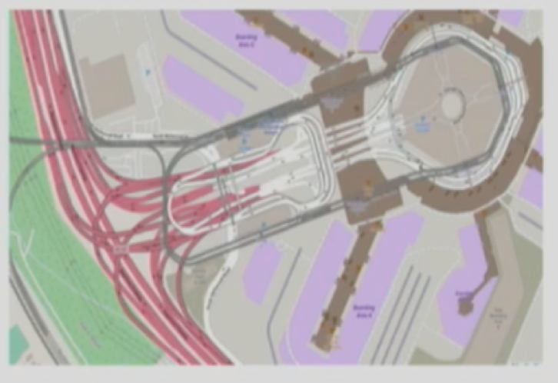
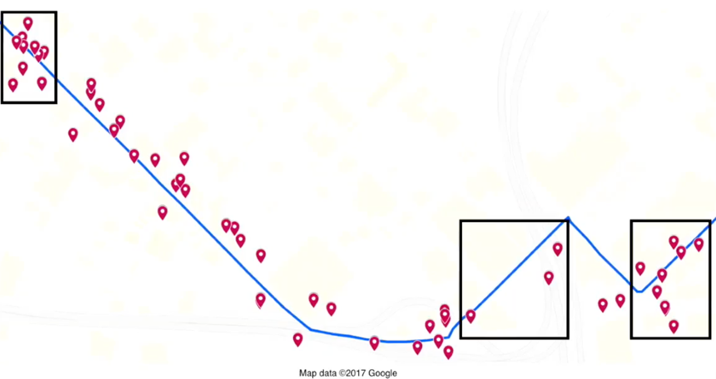
Offline Map Matching
What/How/Why
Noise & Sparseness
Missing GPS
Wrong/Complex Map Data
Notes:
['tʌnl]

Slide 39

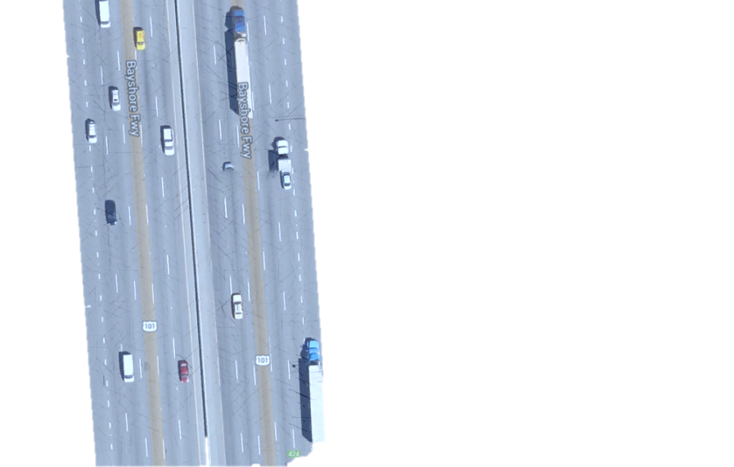
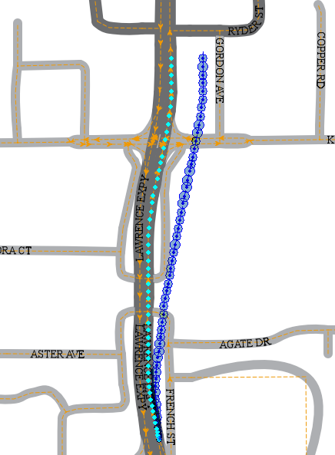
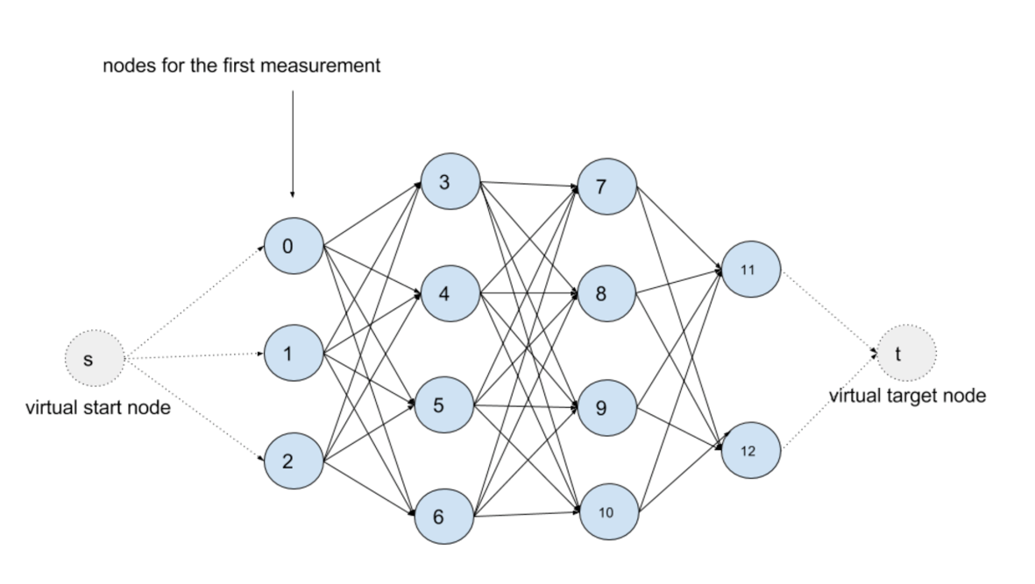
Offboard Map Matching logic
How
Filter noise points
Find Nearest edges as Candidate
Consider Connectivity
Optimal path
99% (2.05*errsize)
Kalman Filter
95% (1.65*errsize)
67% (1.00*errsize)
Emission Probability
MM Fix
DR Fix
Road Width
dmin
Transition Probability
Viterbi Algorithm
Hidden Markov Map Matching

Slide 40
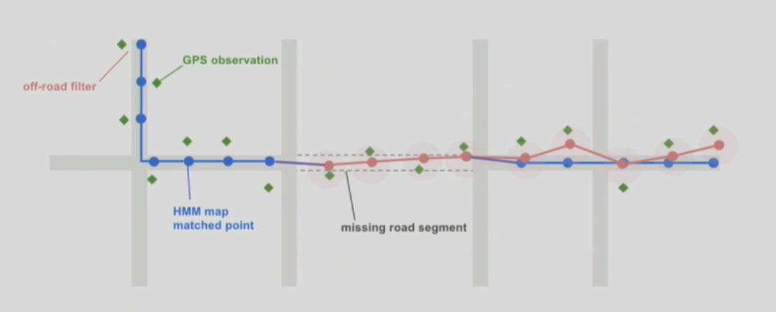

When map is wrong
High confidence
High confidence
Low confidence

Slide 41

Lesson learned
Application is not the key of success, the data is.

Slide 42

When map is wrong (LYFT’s way)

